Slide 1
Chamber Blue
of Kansas

Slide 2
What is an Association Health Plan (AHP)?
A type of group medical insurance for organizations that allow smaller companies to access the health insurance savings associated with large group medical coverage.

Slide 3
Who regulates an Association Health Plan?
Kansas Insurance Department
Department of Labor
Notes:
The DOL rules state that similar type business can pool for insurance and the recommendation is that associations pursue bonafide status. We understand that the chamber AHP could not meet these requirements. However, the DOL has not enforced this policy and mixed businesses have been able to form an association group. Should the DOL change position and enforce current rules, the AHP would have to comply. KID would likely approve a fully insured association under the Kansas insurance code.

Slide 4
How do AHPs work?
Employers band together to purchase insurance
This allows for more people in the pool
The more people included, the more options, and potentially lower cost

Slide 5
Better insurance plans + competitive rates =
More Value

Slide 6
Long-term success + Best practices
Carrier expertise and reputation
Stability of rates is respected and valued
Large group benefits available to smaller employers
New entrants should be underwritten
Rates are directly impacted by experience

Slide 7
Value for your members
More buying power
More choices
Competitive rates

Slide 8
Largest provider network in Kansas

Slide 9
Coverage outside of Kansas + around the world
92%
96%
of physicians in-network
of hospitals in-network

Slide 10
Exclusive provider discounts
$3.1 Billion
59%
in provider discounts
savings on common medical services

Slide 11
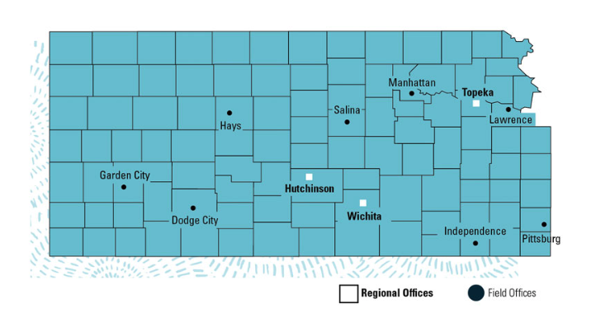
Sales support
One-on-one support throughout Kansas
40 Kansas-based reps located across the state
Telephone, virtual or on-site
Member benefit communication & education

Slide 12
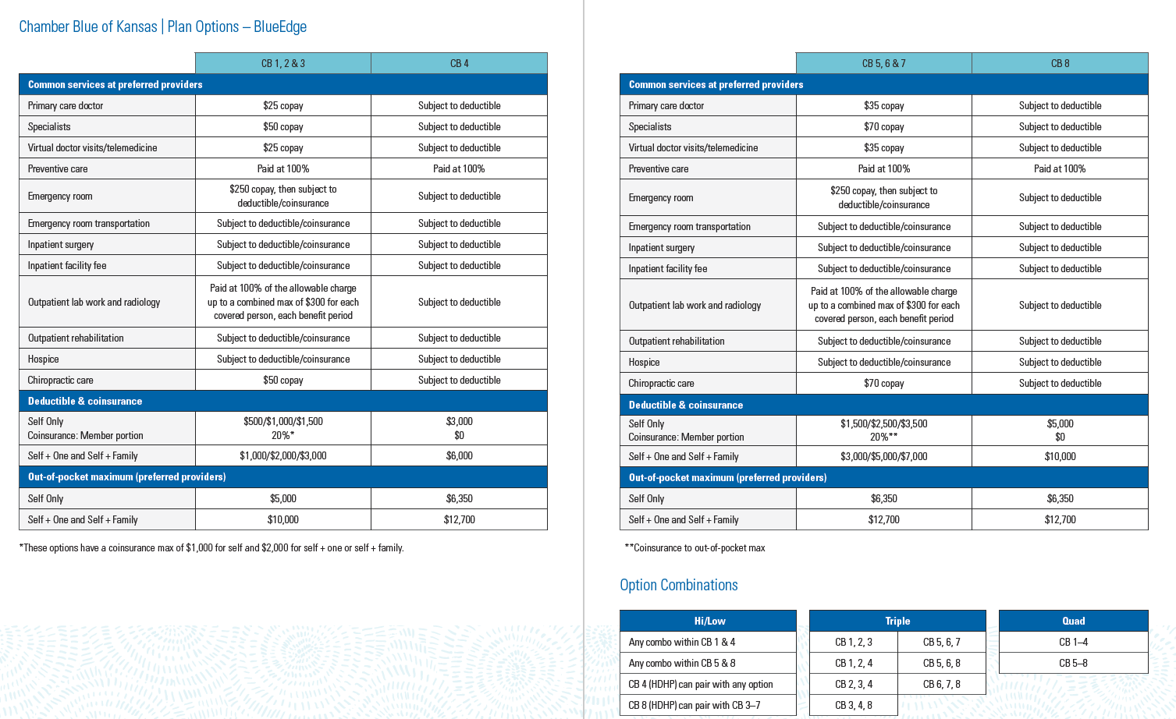
Marketing communication and support
Resource website for chamber members:
bcbsks.com/chamberblueks

Slide 13
Marketing communication and support
Employer communications:
Website: bcbsks.com/chamberblueks
Informational webinar with live Q&A
Chamber Blue of Kansas brochure
Email templates to help communicate with employees about the plan, when and how to enroll, etc.
Employee/Member communications:
Website with benefit and enrollment information
Informational webinar
Benefits brochure with rates
Enrollment worksheet to help decide what plan fits their needs
Spanish materials available

Slide 14
How does it work? – The Employer
Employer must be an active member in good standing with their local participating Chamber
Have 50 or fewer full-time equivalent employees
Limited liability companies could qualify based on tax classification – determination by BCBSKS.
Employer must complete the required employee survey and provide rating documentation if you are a new business looking to enroll in Chamber Blue of KS for the 1st time. If you are currently enrolled in the Chamber Blue of KS association, you do not need to complete this survey.
Meet underwriting and risk requirements of Chamber Blue of KS for businesses enrolling for the 1st time.
Employer needs pay at least 25% of the lowest cost plan option offered.
If the Employer exits Chamber Blue of KS, the Employer cannot re-enroll for 3 years.

Slide 15
Timeline
June 2023
Promotion of Chamber Blue to new chambers and new businesses
July 1 – August 18, 2023
Survey results collected
September 2023
Rating
October 2023
Renewal to CCEKS
Renewal communication to existing groups and new businesses
November 1-15, 2023
Member enrollment: New groups and Renewals
December 1, 2023
Rates finalized
December 22, 2023
Member welcome materials & ID cards are mailed

Slide 16
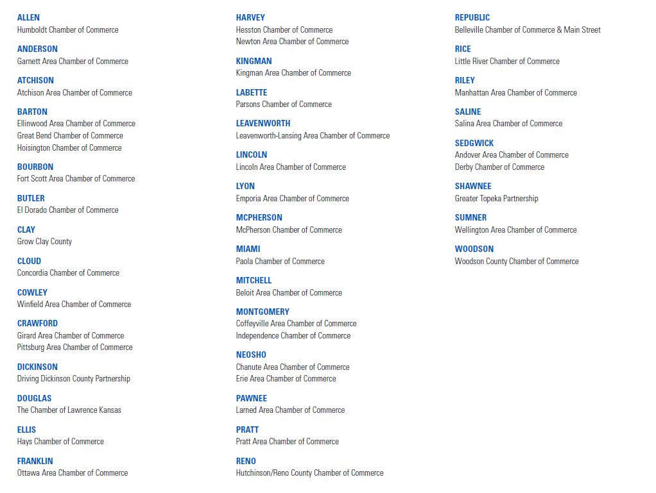
Chambers Committed to Chamber Blue of KS

Slide 17
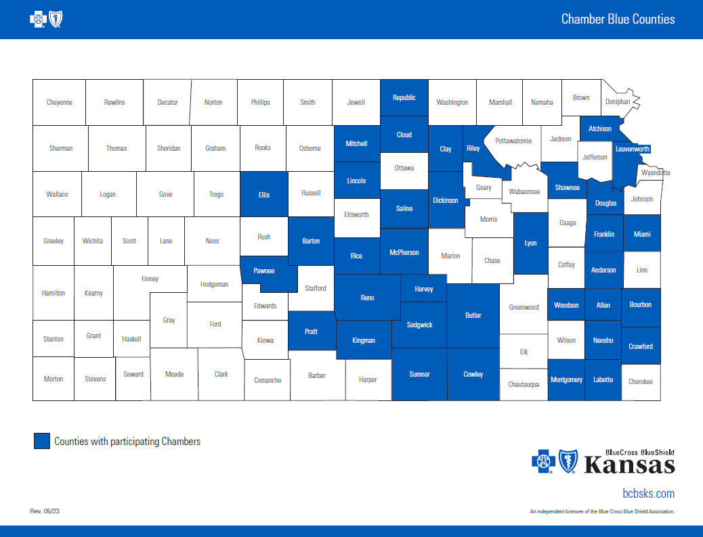

Slide 18
HealthyOptions
Your resource for living a healthier life
Hands-on health tools
Disease and case management
Behavioral health
Personalized health and wellness platform, powered by WebMD ONE & mobile app
Blue365

Slide 19
A faster, easier way to see a doctor
Telehealth through Amwell connects you with a doctor anytime, anywhere
Consult with a doctor by computer, tablet or phone
Affordable, easy and convenient – available 24/7/365
A choice of trusted, U.S. board-certified doctors
No appointment, no waiting
Prescriptions as needed

Slide 20
Instant information. Always on.
bcbsks.com
BlueAccess® member portal + Mobile App
Doctor & Hospital finder

Slide 21
Prime Therapeutics
myprime.com
Pharmacy benefit manager
On-site doctors, pharmacists and nursing staff

Slide 22
Range of products
Advance Insurance Company of Kansas
Life insurance (Basic & Voluntary)
Disability insurance
Dental
Specialty benefits | Secure 300/Secure HIP

Slide 23
Active in the Community
Support across Kansas
Bike share programs
Harvesters
United Way projects
Ronald McDonald House
Go Noodle
March of Dimes
and more...

Slide 24
Jeremy McGuire
Group Sales Advisor

Slide 25
Glossary
Allowed Amount
The amount Blue Cross determines as the maximum amount paid for the medical service provided.
Coinsurance
Coinsurance is your share of the cost of a covered medical service after you’ve met your deductible for your benefit period.
Contract Count
Number of employee contracts enrolled within each business. An employee could enroll as employee only, or as a family and it would be considered as one contract. This will be the number that is used to calculate group participation requirements. The employee is issued one contract or agreement that outlines the benefits to be paid on their behalf to a third party if certain defined events occur.
Copayment or Copay
A copayment is the set dollar amount you pay (for example, the $20 you pay when you check out at the doctor’s office) for medical services or prescription drugs at the time you receive them.
Deductible
A deductible is the set dollar amount you pay toward covered medical services each benefit period before Blue Cross starts paying toward those services.
Eligible
Provisions contained in each health benefits plan that specify who qualifies for coverage under that plan.
Group
The business organization or legal entity which has entered into the contract with BCBSKS, for the provision of medical and hospital services.
Member
A term used to broadly define any person who is enrolled with benefits. For purposes of internal and external communications, a member may include an insured, a policyholder, a subscriber, or a dependent. A member must be a policyholder to vote in person or by proxy at BCBSKS policyholder meetings.
Tiers
Employee; Employee and Children; Employee and Spouse; Employee and Dependents – These are the four tiers that are available to an employee for enrollment. Each tier would be considered one contract.
.

